Slide 1
Improving Health Informatics Competencies with OpenEMR
Luddy School of Informatics, Computing, and Engineering
INDIANA UNIVERSITY

Slide 2
INTRODUCTION
The IU Luddy School of Informatics and Computing is at the forefront of healthcare informatics education, leveraging OpenEMR across a variety of courses.
Our curriculum is designed to provide students with a comprehensive understanding of electronic medical records (EMR) systems through practical, hands-on experiences.
Here, we spotlight the unique application of OpenEMR in four distinct courses, showcasing the versatility and depth of learning opportunities available to our students.

Slide 3
CLINICAL INFORMATION SYSTEMS (INFO B-535)
COURSE OVERVIEW:
The Clinical Information Systems course is a comprehensive online graduate program designed to equip students with essential knowledge and skills in healthcare informatics.
Spanning sixteen weeks, this course covers key topics such as human-computer interfaces, systems design, healthcare decision support, and the integration and evaluation of clinical information systems.
This course prepares students for real-world applications, enabling them to analyze, assess, and apply informatics solutions effectively in their future careers as health informatics professionals.

Slide 4
OpenEMR IN THE COURSEWORK:
The assignment is designed for students to engage with OpenEMR, by conducting a hands-on usability study and data entry project. Here’s an overview:
Teams of 3-4 students are tasked with creating realistic patient case data for 3-4 assigned patients.
Each team member selects one patient and is responsible for researching and generating detailed case information, including demographics, medical history, and specific health incidents. This data is then entered into the OpenEMR system.

Slide 5
.
HOW STUDENTS DO THE ASSIGNMENT:
For the OpenEMR assignment, students are divided into teams of 3-4 and are tasked with creating demonstration videos showing how they complete specific tasks within the system. Each team member rotates through four distinct roles to ensure a comprehensive learning and demonstration experience:
Team Manager: Manages time, provides clarity and direction, keeps the team focused and efficient.
Team Speaker/Representative: Communicates with the team and external sources if needed, presents team conclusions, and demonstrates tasks on OpenEMR via screen sharing.
Reflector/Strategy Analyst: Observes and reports on team dynamics, ensures consensus is reached on responses, and keeps track of the learning process.
Recorder: Keeps a log of team member roles, discussion points, insights, and key learning concepts.
Process:
30 minutes per task set, with role rotation for each new video.
Separate video recordings for each task set.

Slide 6
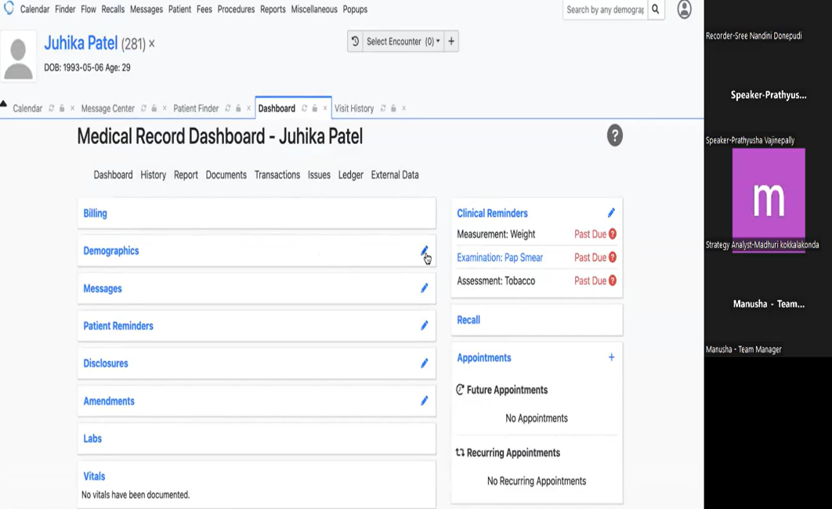
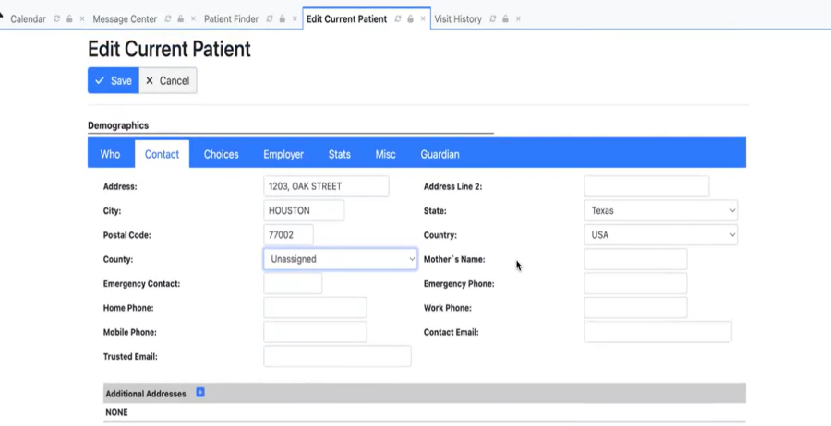
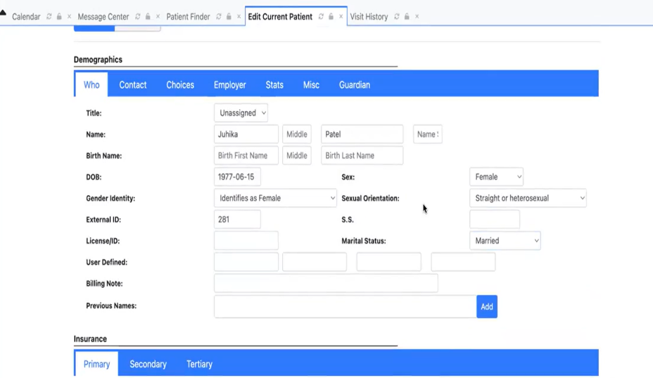
.
Patient Demographics & Vitals

Slide 7
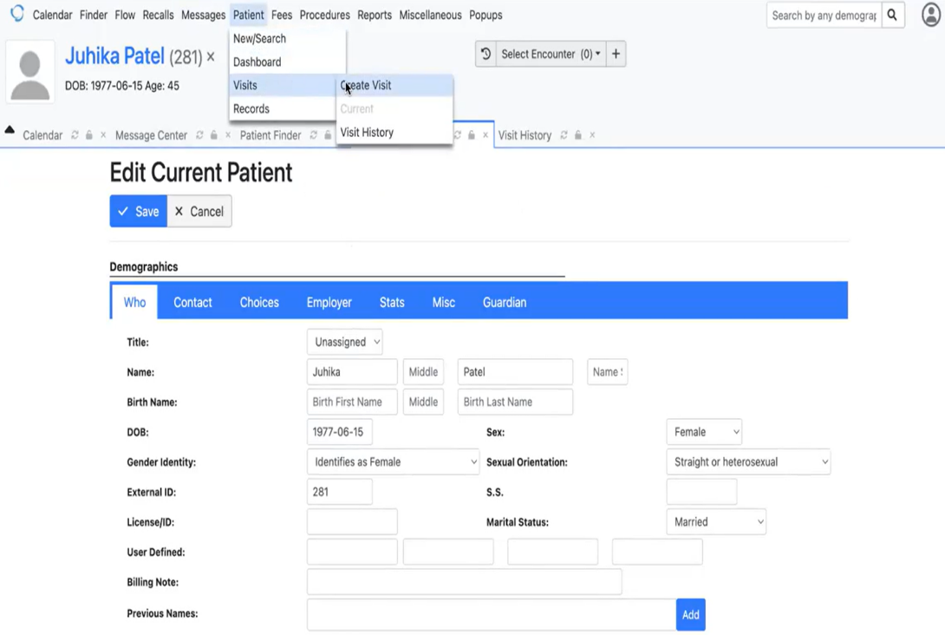
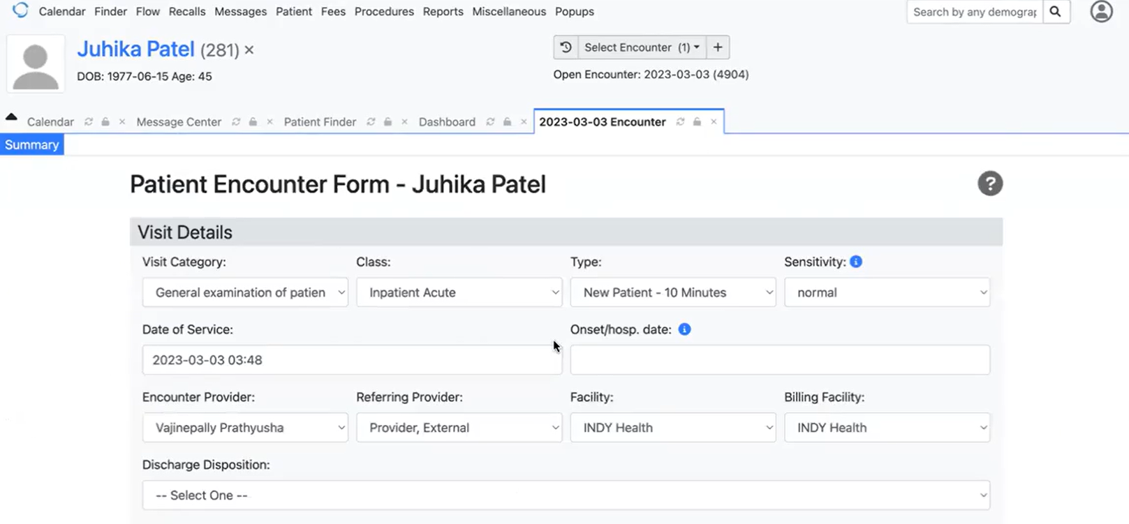
.
Creating a Visit

Slide 8
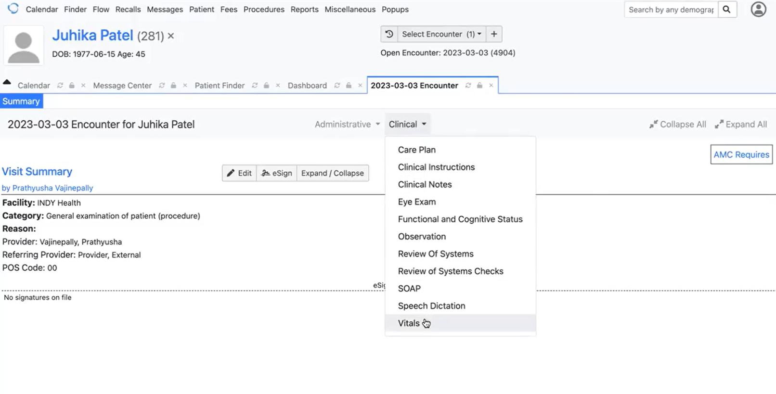
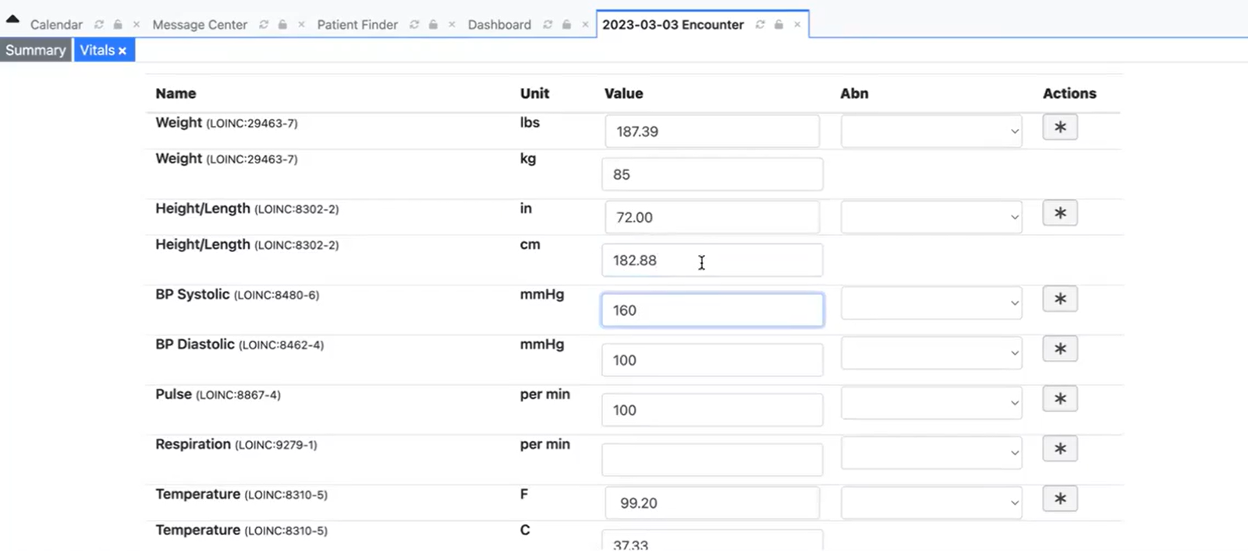
.
Recording Vital Signs

Slide 9
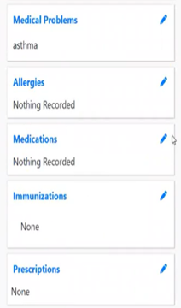
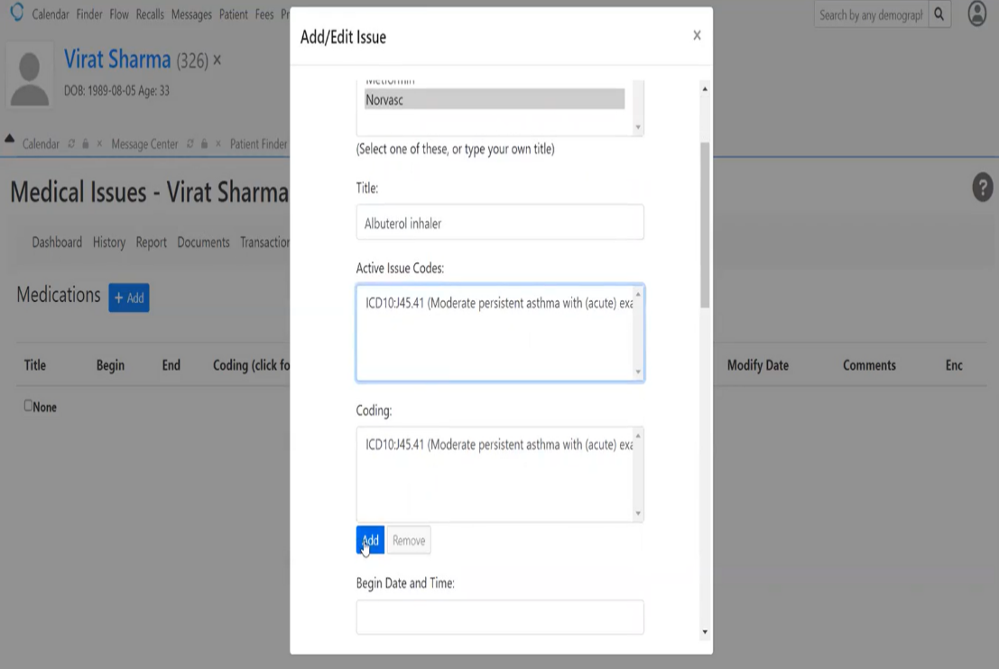
.
Diagnosis & Medication

Slide 10
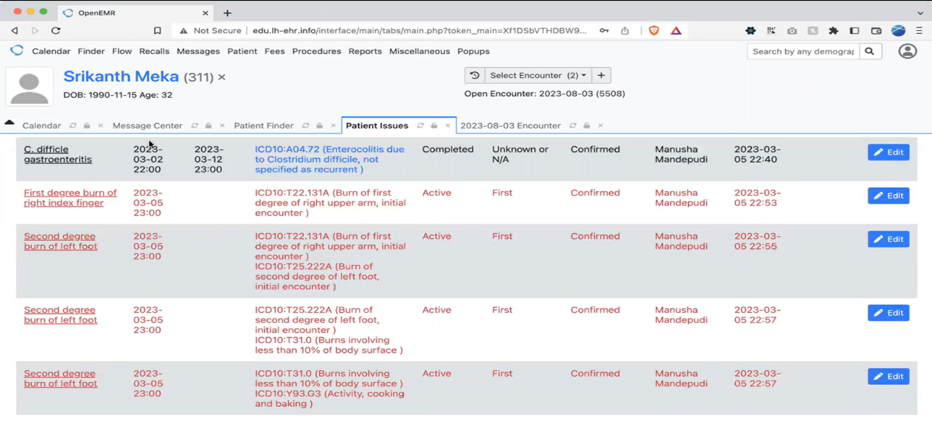
.
Documenting Misadventures
Document an amusing misadventure and its resultant injury.

Slide 11
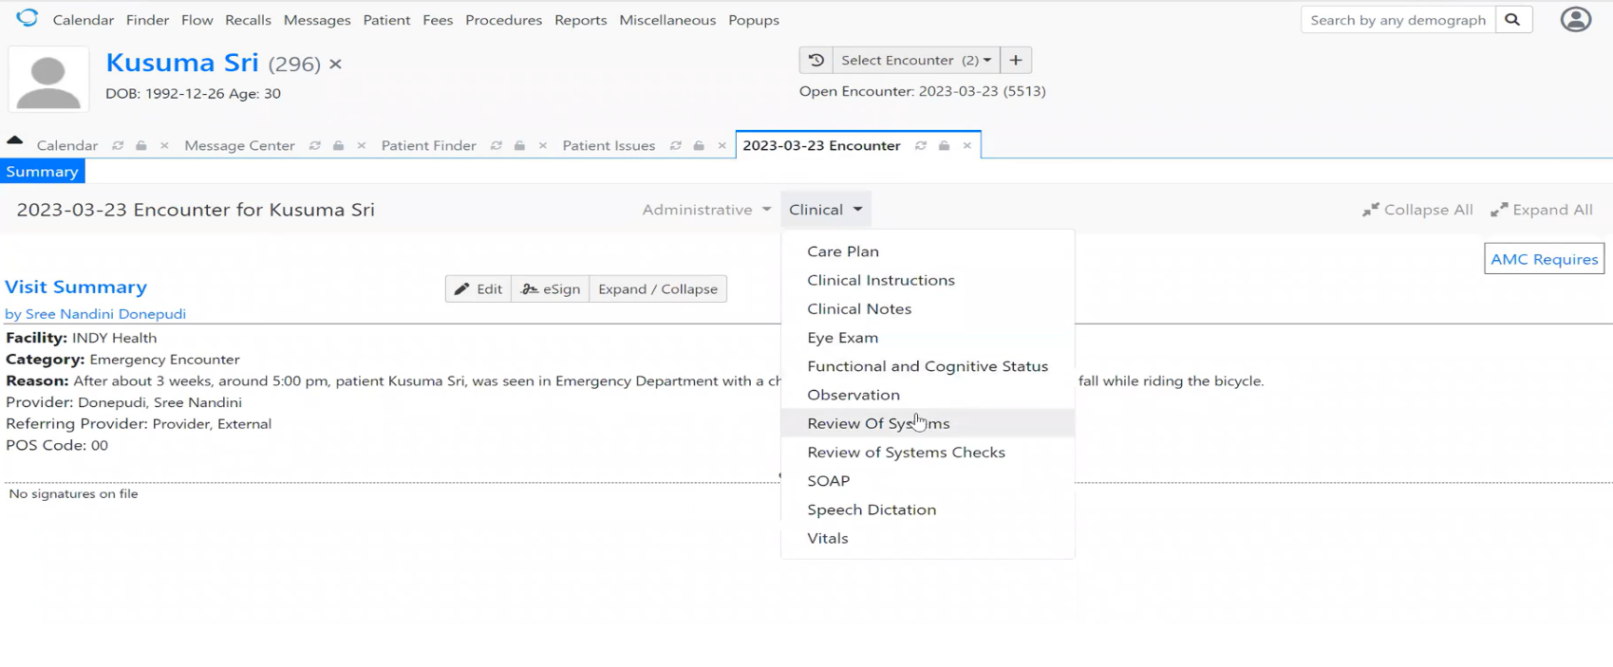
.
Review and Follow-Up

Slide 12
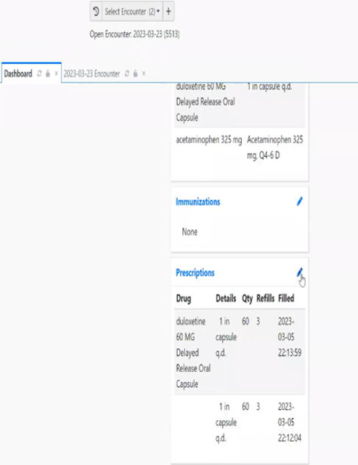
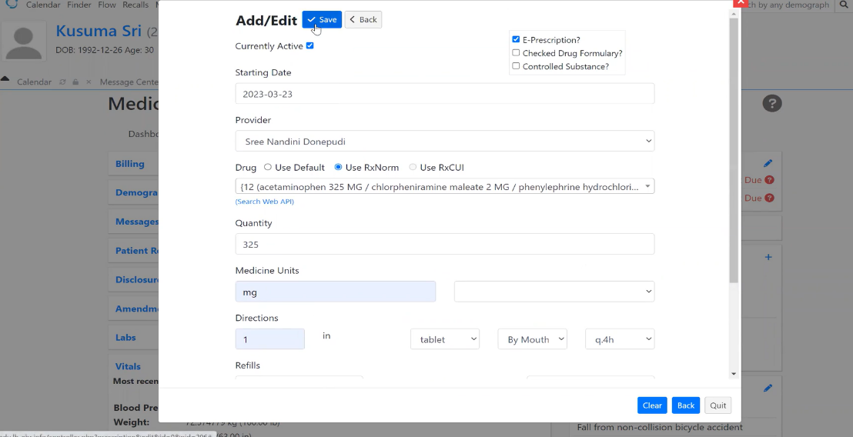
.
Writing Prescriptions

Slide 13
USABILITY ASSESSMENT
Students are required to apply a usability rubric for all tasks, with each team member utilizing it to evaluate the system.
The rubric is structured as follows:
Task Difficulty: where 0 is expected difficulty or less, 9 is excruciating and 10 is failed.
Task completion time: 0 is expected or less, 9 is excruciating, 10 is failed.
What was “in the wrong place”- and where you expected it to be
Any helpful suggestions for the EMR development

Slide 14
.
CLINICAL DECISION SUPPORT SYSTEM (INFO B-642)
COURSE OVERVIEW:
This course offers a deep dive into the realm of computer-based Clinical Decision Support (CDS) and Clinical Decision Support Systems (CDSS), touching upon design principles, usability, cognitive support, and their applications in clinical practice.
It operates on an asynchronous learning model, where there are no set class times; instead, students engage in discussions and coursework within a specified weekly period, dedicating 15-18 hours each week to this three-credit course.
The course encourages a collaborative knowledge exchange, where students are urged to share their varied levels of knowledge, expertise, and skills, thereby creating a rich, diverse learning environment that benefits from the unlimited perspectives and insights of its participants.

Slide 15
.
WHAT IS THE ASSIGNMENT ABOUT
Students are divided into groups, with each group tackling a specific clinical problem. The tasks involve:
Review and assess clinical problems within student groups, focusing on the application of Clinical Decision Rules (CDRs) in Open EMR.
Configure and set up CDRs in Open EMR, establishing criteria that prompt specific actions or alerts within a patient's record based on predefined conditions.
Engage in hands-on exercises by entering patient demographics, medical problems, and other relevant data to observe the response of the system's rules in real-time scenarios.
Document the outcomes and interactions during the exercises to facilitate active learning and provide valuable insights into the practical use and impact of CDRs in healthcare.

Slide 16
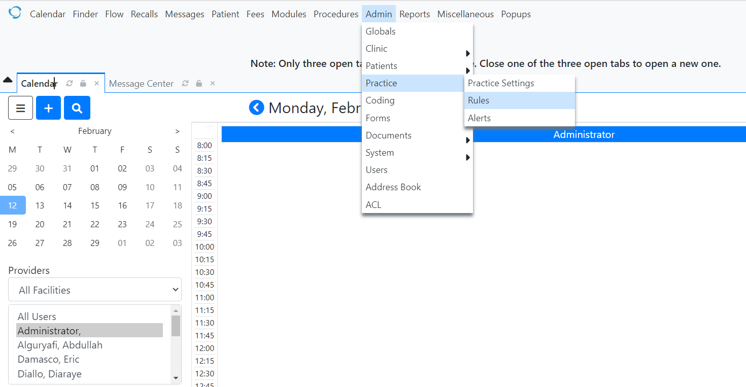
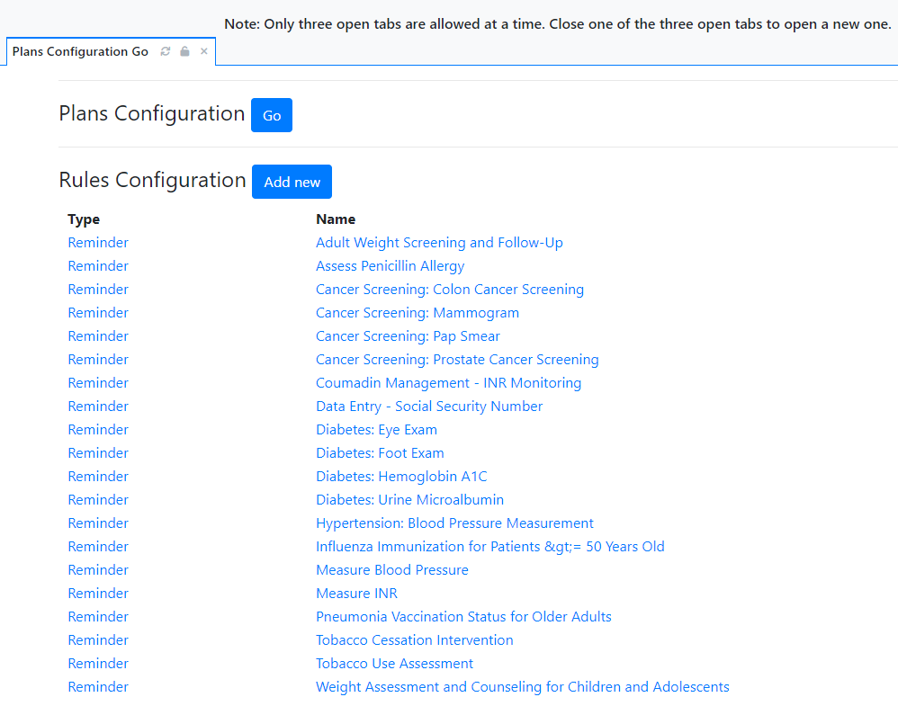
.
HOW STUDENTS DO THE ASSIGNMENT
Students will begin with reviewing the Clinical Problem Assessment by navigating to Administration >Rules>
<The Clinical problem assigned to their group in Canvas>

Slide 17
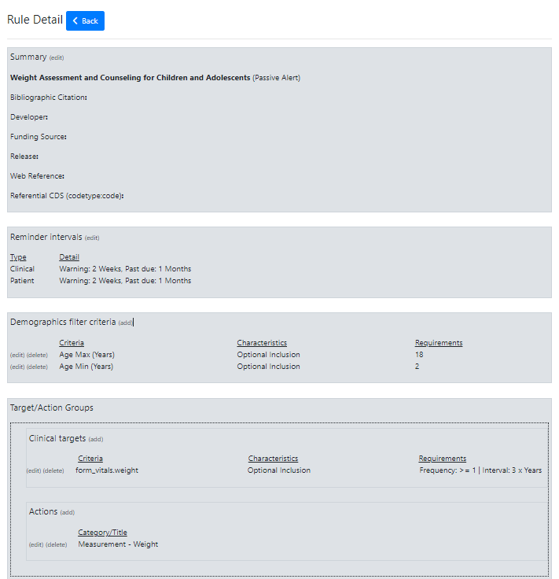
.
Students should begin by accessing "Summary" section to name the rule and determine its type, such as an active alert, passive alert, or patient reminder.
They should move to the "Demographics Filter Criteria" section to set filters based on relevant patient information like age, gender, or medical history.
In the "Target/Action Groups" section, students can define the clinical targets and actions. This involves specifying what triggers the rule (clinical targets) and what actions should occur when the rule is triggered.

Slide 18
.
DATABASE DESIGN (M200)
COURSE OVERVIEW
This course introduces the principles of relational database design, focusing on data management in healthcare, including creating data tables, establishing relationships, and ensuring
data integrity through normalization.
Teaches students to assess and implement database systems that comply with healthcare
regulations, with practical experience in generating user forms and analytical reports.
Features a comprehensive group project that simulates real-world scenarios allowing
students to apply database management concepts, such as user interface design and data
normalization, to create solutions for challenges faced in the health information management
field.

Slide 19
WHAT THE ASSIGNMENT IS ABOUT:
The assignment revolves around a practical application of skills in an electronic medical record system, OpenEMR. Students will engage in group activities to enter and edit patient data within a simulated EMR/EHR environment. The tasks include:
Assigning roles within the group and selecting patients from a provided list to work on.
Completing a set of tasks for each patient, such as entering fictitious patient information, adding vital signs, and creating encounter data.
Each group member must document their experience in a usability report, noting any difficulties encountered and suggesting improvements.
Creating demonstration videos in which they show how they completed the tasks for their assigned patient.

Slide 20
.
HEALTH INFORMATION MANAGEMENT (M355)
COURSE OVERVIEW
This course provides an in-depth study of the International Classification of Diseases (ICD), specifically
ICD-10-CM and ICD-10-PCS, with additional insights into ICD-9 and ICD-11. It prepares students to
understand and apply accurate diagnosis and procedure codes.
Students will use the latest editions of essential texts, including MindTap for Bowie's Understanding
ICD-10-CM and ICD-10-PCS and the 2024 ICD-10-PCS and ICD-10-CM Expert books, facilitating a thorough
understanding of coding practices.
The curriculum emphasizes accurate coding guidelines, ethical coding practices, and the application of codes to medical documentation, aiming to build core competencies in data structure, content governance, and revenue cycle management.

Slide 21
.
ASSIGNMENT DESCRIPTION
This assignment is in the form of a practical quiz where students are required to interact with the OpenEMR system to access and review patient records.
The quiz format is chosen to test student's abilities to quickly and accurately retrieve and interpret critical patient information, thereby making informed ICD-10 coding decisions.
The tasks within the quiz are designed to simulate real-world scenarios, thereby challenging students to apply their knowledge of medical histories, visit dates, and health conditions to identify the correct ICD-10 diagnostic codes.
Through this quiz, students will not only demonstrate their coding competencies but also enhance their critical thinking and decision-making skills, which are vital for ethical medical coding practices.

Slide 22
DEMO VIDEO

Slide 23

.

Slide 24
Deployment of VMs (Virtual Machines)

Slide 25
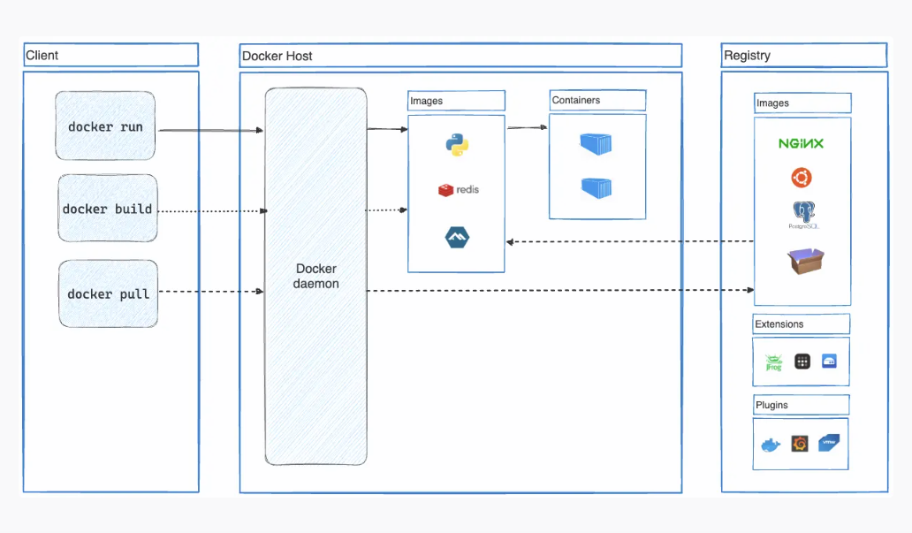
Docker
Docker is an open platform designed for developing, shipping, and executing applications. It allows the isolation of applications from the underlying infrastructure, facilitating rapid software delivery (Docker, n.d.).
It enables consistent management of both applications and infrastructure, leveraging its methods for packaging, testing, and deploying code. This results in a notable reduction in the time gap between code development and its deployment in a production environment (Docker, n.d.).
Docker Architecture:
Docker Daemon
Docker Client
Docker Desktop
Docker Registries
Docker Objects:
Images
Containers

Slide 26
Docker in OpenEMR
https
443 appache reverse proxy
Domain SSL certificate
OpenEMR
MariaDB
Log
Site
Database
Backup/Restore
Docker Daemon

Slide 27
Containers:
OpenEMR Container: This container hosts the OpenEMR application.
MariaDB Container: This container hosts the MariaDB database.
Backup/Restore: Both containers have a backup and restore mechanism in place. It involves regularly creating backups of the data within the containers and possibly restoring them if needed. This is a common practice to ensure data integrity and recovery.
Volumes:
"Database" Volume (MariaDB): This volume in the MariaDB container contains all the data from MIMIC-IV, a database.
"Log volume" (OpenEMR): This stores log data which includes information about errors and possibly other log-related information.
"Site volume" (OpenEMR): This contains data related to changes made, bug fixes, and other site-specific information.

Slide 28
Docker Daemon: The Docker Daemon is the background process that manages Docker containers on a system. It is responsible for building, running, and managing containers. In this context, it ensures that the OpenEMR and MariaDB containers are created, run, and managed properly.
Apache Reverse Proxy with SSL: There is an Apache reverse proxy configured on port 443, which is the default HTTPS port. This proxy handles incoming HTTPS requests and forwards them to the appropriate container, either OpenEMR or MariaDB.
Domain SSL Certificate: SSL certificates are used to secure the communication between clients and servers. In this case, a domain SSL certificate is associated with the Apache reverse proxy, ensuring secure communication over HTTPS.

Slide 29
Applying Patches
sudo su - oemr: Switch to the user "oemr".
docker ps -a: List all Docker containers.
docker exec -it openemr /bin/sh: In this command replace "openemr" with its container id.
apk add nano: Install the nano text editor if it's not already installed.
nano patch1.patch: Open the patch file "patch1.patch" in the nano text editor.
patch -p1 < patch1.patch: Apply the changes from "patch1.patch" to the OpenEMR codebase.
nano patch2.patch: Open the patch file "patch2.patch" in the nano text editor.
patch -p1 < patch2.patch: Apply the changes from "patch2.patch" to the OpenEMR codebase.
nano patch3.patch: Open the patch file "patch3.patch" in the nano text editor.
patch -p1 < patch3.patch: Apply the changes from "patch3.patch" to the OpenEMR codebase.

Slide 30
TEST AUTOMATION
To improve the quality and reliability of OpenEMR, we are working on automating our testing processes.
Tools and Environment:
Development Platform: IntelliJ IDEA with PyCharm plugin.
Languages and Libraries: Python, Selenium WebDriver, Requests library.
Focus: Leverage Python's flexibility for dynamic test script development.
Automated Tests Implemented:
Login Verification: Ensures users can log in with valid credentials and are directed to the appropriate landing page.
Patient Search: Validates the accuracy of patient search results within the system.
Vital Results Navigation: Confirms the ability to navigate to and display a patient's vital statistics.
Our commitment to automating the testing process for OpenEMR underscores our dedication to improving healthcare IT solutions through quality assurance and innovation.

Slide 31
Last Slide----
Website - https://www.open-emr.org/
Main repo - https://github.com/openemr/openemr
Our repo - https://github.com/iupui-soic/openemr
ONC 2015 Cures Update Certified - https://www.open-emr.org/blog/openemr-achieves-onc-2015-cures-update-certification-with-groundbreaking-release-70/

Slide 32
References
Blumenthal, D. (2009). Stimulating the Adoption of Health Information Technology. New
England Journal of Medicine, 360(15), 1477–1479.
https://doi.org/10.1056/nejmp0901592
Docker. (n.d.). Get started. Docker Documentation. https://docs.docker.com/get-
started/overview/
Garrett, P., & Seidman, J. (2011). EMR vs EHR – What is the Difference? Health IT Buzz.
https://www.healthit.gov/buzz-blog/electronic-health-and-medical-records/emr-vs-ehr-
difference/
Khairat, S., Coleman, G. C., Russomagno, S., & Gotz, D. (2018). Assessing the Status Quo of
EHR Accessibility, Usability, and Knowledge Dissemination. EGEMS (Washington,
DC), 6 (1) , 9. https://doi.org/10.5334/egems.228

Slide 33
OpenEMR. (2023). OpenEMR Features. https://www.open-
emr.org/wiki/index.php/OpenEMR_Features
Shakina, E., Parshakov, P., & Alsufiev, A. (2021). Rethinking the corporate digital divide:
The complementarity of technologies and the demand for digital skills.
Technological Forecasting and Social Change, 162, 120405.
Takesue, B. Y., Tierney, W. M., Embi, P. J., Mamlin, B. W., Warvel, J., & Litzelman, D. K.
(2021). Regenstrief teaching electronic medical record (tEMR) platform: a
novel tool for teaching and evaluating applied health information technology.
JAMIA open, 4(1), ooab010. https://doi.org/10.1093/jamiaopen/ooab010
Welcher, C. M., Hersh, W., Takesue, B., Stagg Elliott, V., & Hawkins, R. E. (2018). Barriers
to Medical Students’ Electronic Health Record Access Can Impede Their
Preparedness for Practice. Academic Medicine: Journal of the Association of
American Medical Colleges, 93(1), 48–53.
https://doi.org/10.1097/ACM.0000000000001829

Slide 34
APPENDIX

Slide 35
OpenEMR Installation Using Docker
Step 1: Install PuTTY
Please follow the instructions provided in this link https://www.chiark.greenend.org.uk/~sgtatham/putty/latest.html to download and install PuTTY on multiple platforms like MAC, Windows, Linux.
Step 2: Configure PuTTY
SSH → Auth → Credentials → put.key
SSH → tunnels → Set the source, Destination ports → Add
Open the connection
Step 3: Login using username and password.
Step 4: Install docker
sudo apt-get update
sudo apt-get upgrade
sudo apt-get install ca-certificates curl gnupg lsb-release

Slide 36
sudo mkdir -p /etc/apt/keyrings
curl -fsSL https://download.docker.com/linux/ubuntu/gpg | sudo gpg --dearmor -o /etc/apt/keyrings/docker.gpg echo \ "deb [arch=$(dpkg --print-architecture) signed-by=/etc/apt/keyrings/docker.gpg] https://download.docker.com/linux/ubuntu \ $(lsb_release -cs) stable" | sudo tee /etc/apt/sources.list.d/docker.list > /dev/null
sudo apt-get update
sudo apt-get install docker-ce docker-ce-cli containerd.io docker-compose-plugin –y
(If you face any issues while installing the docker then use the sudo reboot command)
(Create oemr user)
sudo adduser oemr
Enter your password
Click enter and If the information is correct. Click Y(yes).

Slide 37
(Create Docker user)
sudo groupadd docker
sudo usermod -aG docker $USER
(Anything that has docker command should be run by oemr user)
sudo su - oemr
docker run hello-world
exit
sudo systemctl enable docker.service
sudo systemctl enable containerd.service
sudo apt-get install docker-compose –y
sudo su – oemr
nano docker-compose.yml

Slide 38
Step 5: Create docker-compose, Copy paste the entire thing
# Use admin/pass as user/password credentials to login to openemr (from OE_USER and OE_PASS below) # MYSQL_HOST and MYSQL_ROOT_PASS are required for openemr # MYSQL_USER, MYSQL_PASS, OE_USER, MYSQL_PASS are optional for openemr and # if not provided, then default to openemr, openemr, admin, and pass respectively. version: '3.1' services: mysql: restart: always image: mariadb:10.6 command: ['mysqld','--character-set-server=utf8mb4'] volumes: - databasevolume:/var/lib/mysql ports: - 3306:3306 environment: MYSQL_ROOT_PASSWORD: root openemr: restart: always image: openemr/openemr:7.0.0 ports: - 80:80 - 443:443 volumes: - logvolume01:/var/log - sitevolume:/var/www/localhost/htdocs/openemr/sites #- /home/oemr/openemr-devops/docker/openemr/flex-edge/utilities/:/root/ environment: MYSQL_HOST: mysql MYSQL_ROOT_PASS: root MYSQL_USER: openemr MYSQL_PASS: openemr OE_USER: admin OE_PASS: pass depends_on: - mysql volumes: logvolume01: {​​​​​}​​​​​ sitevolume: {​​​​​​​​​​​​}​​​​​​​​​​​​ databasevolume: {​​​​​​​​​​​​}​​​​​​​​​​​​

Slide 39
Remember to change the Docker Compose to point to these volume locations
volumes: - oemr_databasevolume:/var/lib/mysql
volumes: - oemr_logvolume01:/var/log - oemr_sitevolume:/var/www/localhost/htdocs/openemr/sites
volumes: oemr_databasevolume: {external: true} oemr_logvolume01: {external: true} oemr_sitevolume: {external: true}
Click Ctrl+X (save), Y(yes), Enter
Exit
ls –al (to find docker-compose.yml)
Step 6: If you have access to volumes
sudo apt-get install p7zip-full –y
wget <downloadlink>?download=1
mv <longfilename> 3-volumes.7z
7z x 3-volumes.7z

Slide 40
sudo su – oemr
Step 7: The volumes are created and restored.
docker volume create oemr_databasevolume
docker volume create oemr_sitevolume
docker volume create oemr_logvolume01
Exit
sudo su
cd /var/lib/docker/volumes/
ls –al (use this command to check if the volumes already exist)
Remove the volumes if already exist, so that they can replaced by the new volumes
rm –Rf oemr_databasevolume/
rm –Rf oemr_logvolume01/
rm –Rf oemr_sitevolume/

Slide 41
cp -r /home/(enter your username)/oemr_databasevolume oemr_databasevolu
cp -r /home/(enter your username)/oemr_logvolume01/ oemr_logvolume01
cp -r /home/(enter your username)/oemr_sitevolume/ oemr_sitevolume
chown -Rf oemr:root oemr_databasevolume/_data/
chown -Rf oemr:root oemr_logvolume01/_data/
chown -Rf oemr:root oemr_sitevolume/_data/
ls –al (To check if the volumes have been copied with the right permissions)
Exit
sudo su – oemr
docker-compose up

Slide 42
Step 8: Check if the volumes were correctly restored or not.
Start a local connection and check the patient data.
Step 9: Check the webpage. If it does not open then check this.
docker compose up –d
docker ps –a
exec –it <container id> /bin/sh
ls –al
There should not be any numbers(1008,1001 etc), root in the apache column so to change this we do the change ownership.
chown –Rf apache:root .
exit

Slide 43
THANK YOU

